Slide 1


SMART HEALTH PREDICTION FOR AVOIDING FUTURE HEALTH RISK
Under the Guidance of
Mr.T.Pardhu
Assistant Professor
Department of ECE
SR University
1. Shivapriya .P - 19K41A04A9
2. Supraja Lakshmi Devi .S - 20K45A0409
3. Bharghavi Naragani - 19K41A0479
4. Nagaraju Ravula - 19K41A0483

Slide 2
OUTLINE
Abstract
Introduction
Problem Statement
Problem Solution
Use case diagram
Block Diagram
Flow Chart
Software and Hardware Used
Working
Algorithms used
Results
Conclusion
Gantt chart

Slide 3
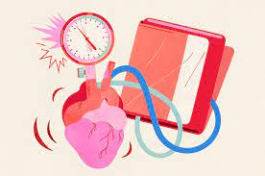
Abstract
It is very crucial to know whether we are suffering from a disease at an early stage, rather than discovering it at a later stage.
Disease Prediction is a supervised system that is used to predict the diseases from the symptoms which are given by the patients or any user.
The system processes the symptoms provided by the user as input and gives the output as the probability of the disease.
Naive Bayes , Random Forest and Decision tree classifiers are used in the prediction of the disease in our proposed system which are supervised machine learning algorithms.

Slide 4
Introduction
Machine learning is being proved to be effective in guiding doctors in making decisions and predictions from the data produced by the health care industries.
Our project aims to predict future Diseases by analyzing data of patients which classifies and detects whether they are suffering with any kind of diseases or not using machine-learning algorithm.
Machine Learning algorithms are very useful in this case. By collecting the data from various sources, classifying them under suitable forms & finally analysing to extract the desired data ie. Predicted disease

Slide 5
Problem statement
Managing the health conditions of people is still a challenging problem for middle class person because of Lack of capital, they step back to consult a doctor. This is considered as the major problem of the people. Knowing the disease in prior is far better than, curing and caring.

Slide 6


PROBLEM SOLUTION
Detection of many diseases can be benefited rather than making a model which is used only for single disease.
The method we approached is giving the inputs of symptoms and retrieving the output as disease occurred. Because this is an effective method compared to all other methods.
The classifiers we use could work most effectively, compared to other classifiers.

Slide 7


USE CASE DIAGRAM
Collect data
Select algorithms
Data pre-processing
Train and test model
USER
Calculate accuracies
DEVELOPER
Create user interface
Gives input symptoms
Gets output disease

Slide 8

BLOCK DIAGRAM
Import Kurimotla general hospital database
Import patient health details
Pocessing the data
Train data
Test data
Proposed Model
Check accuracy score
predicted disease

Slide 9



Performing K-Fold cross validation for model selection
FLOW CHART
Train
Data
Pre-processing and spitting the data
Training random forest
Training Decision tree classifier
Training naïve bayes classifier
Test data(20%)
Dataset
Computing metrics on test data for Decision tree classifier
Computing
metrics on test
data for naive bayes classifier
Computing
metrics on test
data for random
forest
Validation
Data
Predictions on validation dataset by Decision tree classifier
Predictions on
validation dataset
by naive bayes classifier
Predictions on
validation dataset
by random forest
Final prediction
.asfasf

Slide 10

REQUIREMENT SPECIFICATION(S/W & H/W)
Hardware Requirements
System: Pentium 4, Intel Core i3, i5, i7 and 2GHz Minimum
RAM: 4GB or above
Hard Disk: 10GB or above
Software Requirements
OS : Windows 8 or Higher Versions
Platform : Visual Studio Code / Jupiter Notebook
Program Language : Python.

Slide 11
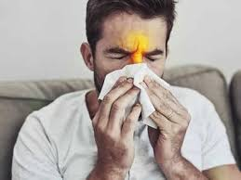

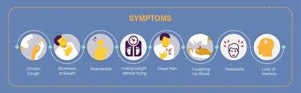
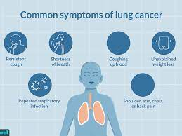

WORKING
The system processes the symptoms provided by the user as, we give five effective symptoms of people as inputs and gives the output as the probability of the disease.
Naive Bayes , Random Forest and Decision tree classifiers are used in the prediction of the disease in our proposed system which are supervised machine learning algorithms.

Slide 12
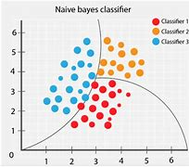
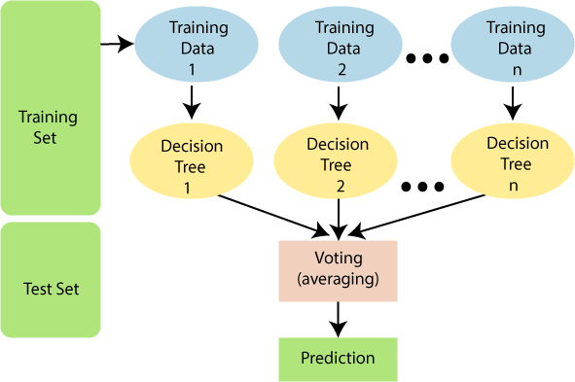
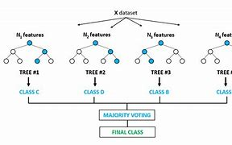
Machine Learning Algorithms used
Naïve Bayes
Decision Tree
Random Forest

Slide 13
Comparative results analysis
Model | Training Accuracy | Testing Accuracy
Naive bayes | 73.4% | 73%
Decision Tree | 95% | 72.4%
Random Forest | 95% | 70.4%

Slide 14
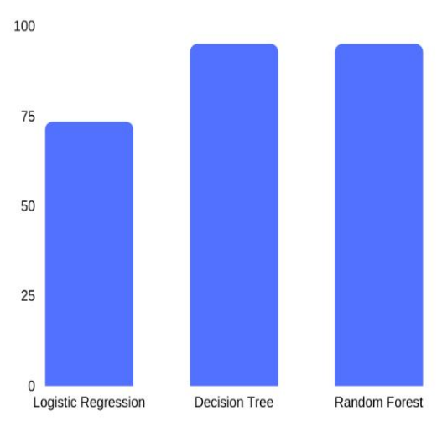
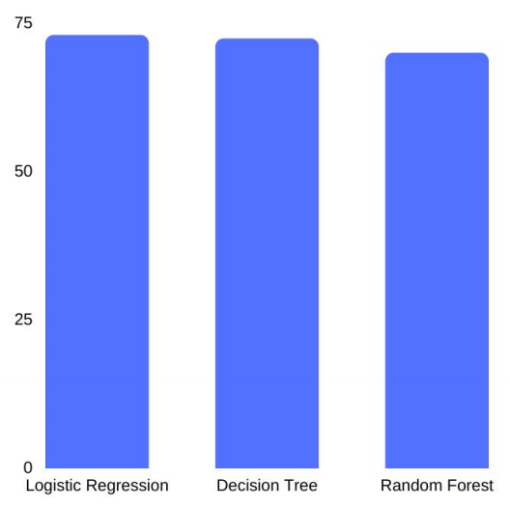
Training Accuracies Testing Accuracies

Slide 15
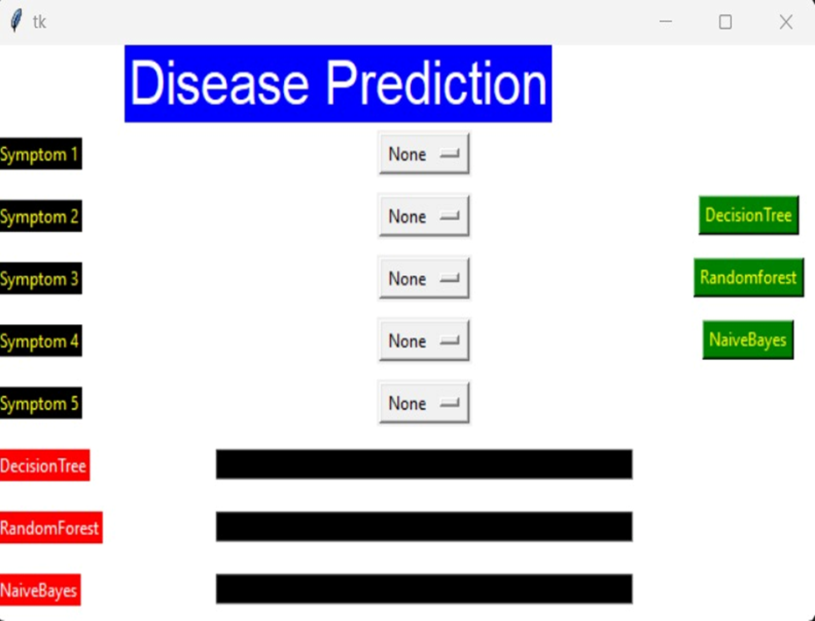
Results: Step -1

Slide 16
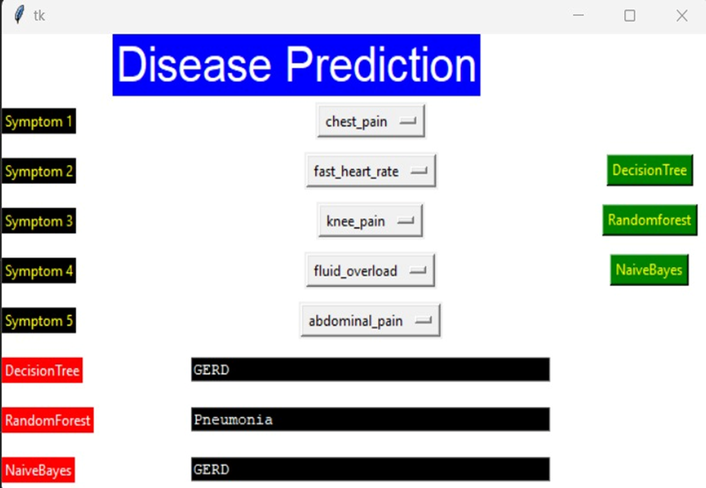
Step -2

Slide 17
CONCLUSION
Early checkups can help in making the right decisions which can lead to reduction oh high complication risks. Having a technology like the machine learning will show a great impact on our current society. A full suitable technology can be so beneficial to the health care industries.To conclude, we have developed a machine learning model to predict whether the person is infected with any disease or the person is healthy.

Slide 18
FUTURE SCOPE
This project can further improved by
Giving Dietary Recommendations
Suggestions about Physical Exercise.
Improve the accuarcy.
Data mining can be of very good help.
Add many symptoms to the data sets.

Slide 19
GANTT CHART
Module name | Aug - Sept | Sept - Oct | Oct - Nov | Nov - Dec | Dec - Jan | Jan - Feb
Problem Identification & Abstract
Literature Survey
Methodology
Code Development
Testing
Report and Paper writing

Slide 20


